Slide 1

Kingston University London Faculty of Science, Engineering And Computing MSc Degree in Data Science CI7340: Applied Data Programming

Slide 2
Social Implication and Impact of Crime on wider Society
Presented by KU Number: K2217426 KU Number: K2243949 KU Number: K2171125 KU Number: K2172452 Supervised By: Dr Farzana Rahman Dr Jad Abbass

Slide 3
Outline:
Introduction
Initial Data Analysis
Quality of Measurements
EDA
Research Questions
Conclusion

Slide 4
Introduction:
In today’s session, we will be having discussion about the cause and analysis about increasing crime rate in Montgomery county.
Describing the Data analysis done on the dataset and come to conclusive outcomes to prevent crime rates in this county.

Slide 5
Initial Data Analysis:
Data Preparation:
Data Screening
Data Cleaning
Reporting:

Slide 6
Data Preparation:
We first import the prerequisite libraries and packages to start the implementation portion of our analysis.
Below is a list of all libraries utilised in the project:
1. Numpy
2. Pandas
3. Seaborn
4. Matplotlib
5. Math
6. Plotly
7. Pandas-Profiling

Slide 7
Data Screening:
Finding the Abnormal data from the Data set.
The first step in resolving this is to identify all columns across the entire dataset that contain missing values. The number of missing values in all columns
The provided dataset is missing around 9.4% of its actual value. If missing data were neglected, the entire analysis might end up being insufficiently accurate.

Slide 8
Data Cleaning:
Data cleansing, also known as data cleaning or scrubbing, identifies and fixes errors, duplicates, and irrelevant data from a raw dataset.
Part of the data preparation process, data cleansing allows for accurate, defensible data that generates reliable visualizations, models, and business decisions.
Missing data
Outliers
Normality

Slide 9
Missing Data:
Eliminating the columns that contain blank data: This is an extreme instance and should only be applied when the column has a large number of null values. Like Street Prefix and Street Suffix.
Eliminating the rows that contain blank data: You can remove the entire row and all its characteristics if a specific row has missing data.
Imputation: the process of substituting a value for missing data
Replace the value with mean, median and mode on Numerical Data.

Slide 10
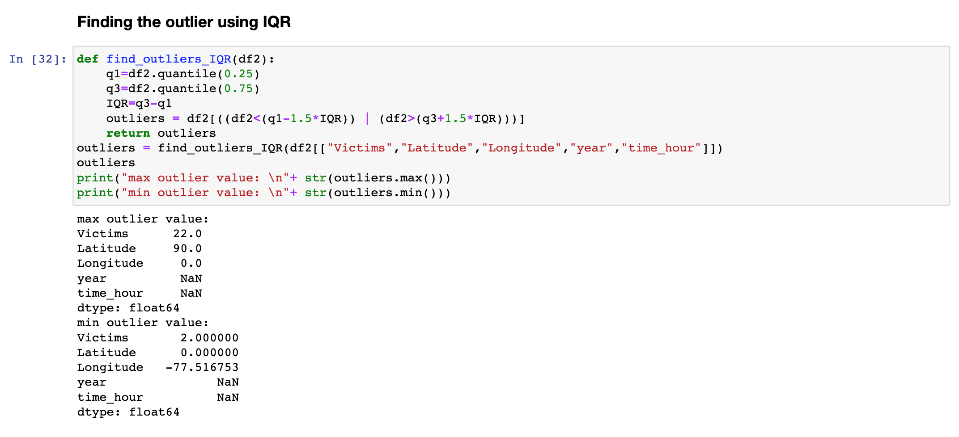
Outliers:
Sort your data from high to low
Identify the median, the first quartile (Q1), and the third quartile (Q3)
Calculate your IQR
IQR = Q3-Q1
Drop the outliers using dropna method.

Slide 11
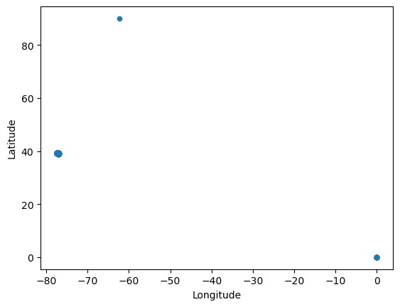
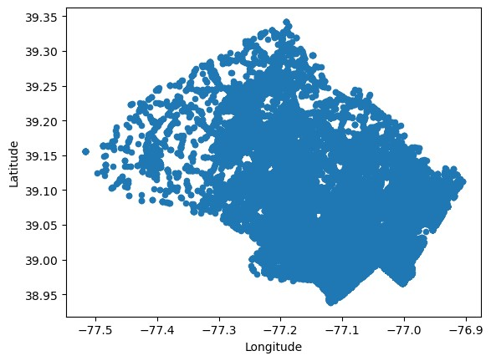
Scatter plot for Outliers

Slide 12
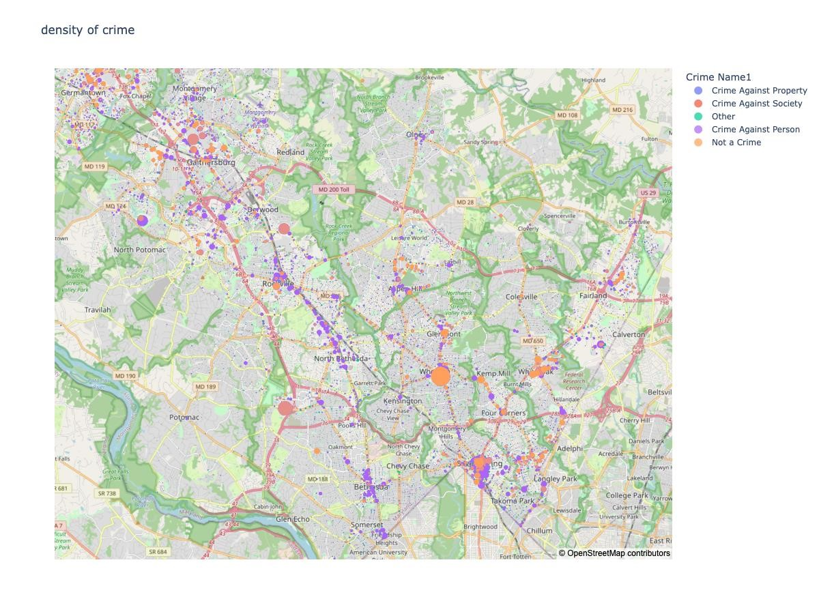
Mapbox plot for Outliers

Slide 13
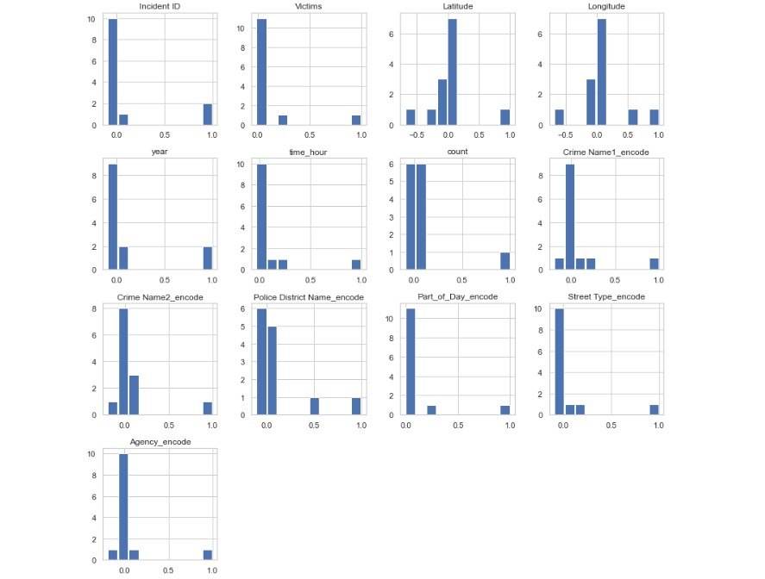
Nomality: Normality test is used to check if a variable or sample has a normal distribution

Slide 14
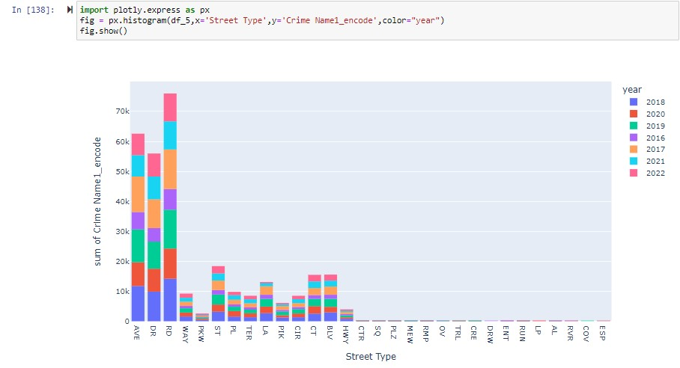
Nomality:

Slide 15
Quality of Measurements:
Accuracy
Completeness
Uniqueness
Validity

Slide 16
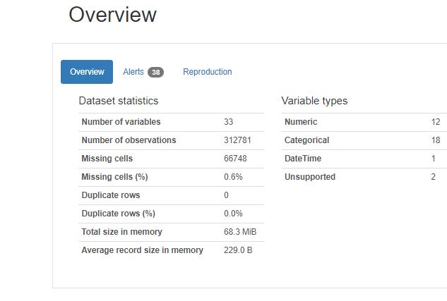
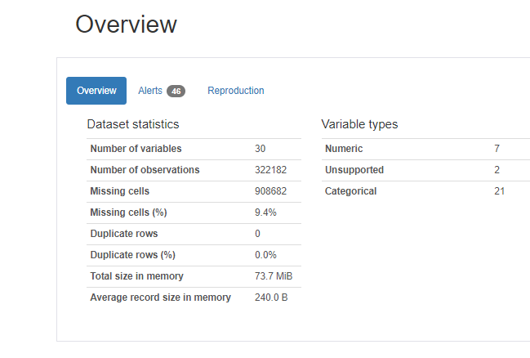
Overview of Entire Datasets

Slide 17

Exploratory Data Analysis
Getting the Data
Understanding the data
Cleaning the data
Bivariate Analysis
Performing Visualizations

Slide 18

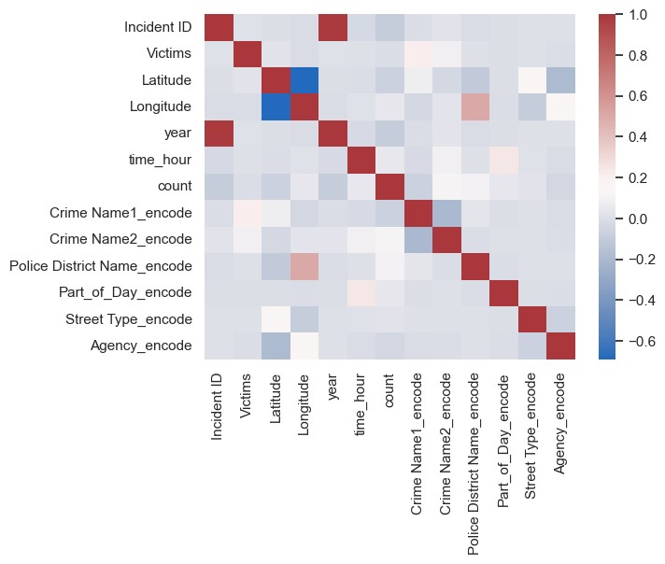
Why Exploratory Data Analysis?
Key factor to perform EDA is to justify the underlying structure of Data.
Sometimes dataset might be small or large depending upon the requirements, so it will be difficult to asses anything on larger dataset.
EDA ensures that in the end , you will end up with some conclusive analysis.
Helps to identify errors in Dataset.
Describes the relationship among variables ( if there is any )

Slide 19
Bivariate Analysis:
This analysis checks the relationship between two variables.
Here we can use Scatter plot or Correlation matrix to justify the relation.
From the matrix shown, the matrix component values between two columns is either nearby to 1 or less which determines these columns are independent and there is no relation between them

Slide 20
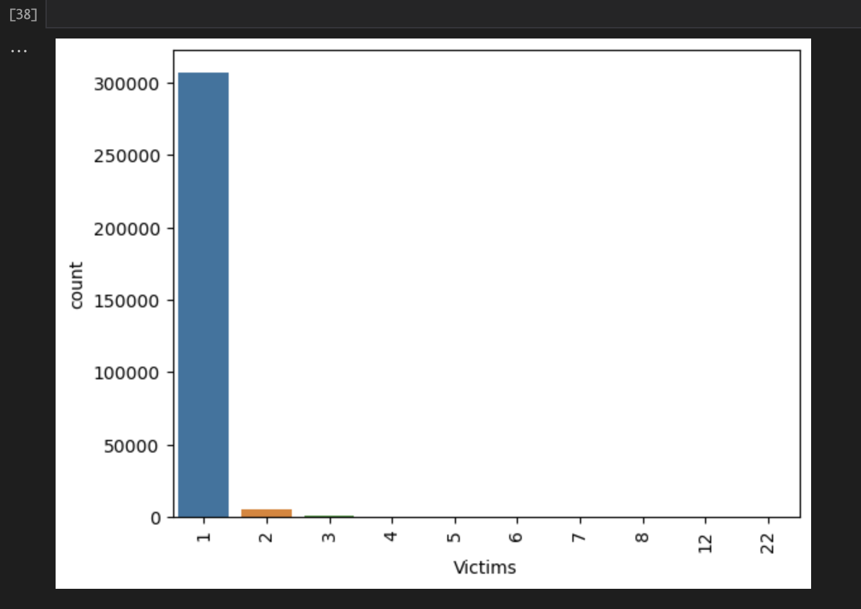
Trends understanding different Scenarios
Trends understanding different Scenarios
Trends in understanding average crime throughout the years.
Trends in understanding average crime throughout the years.

Slide 21
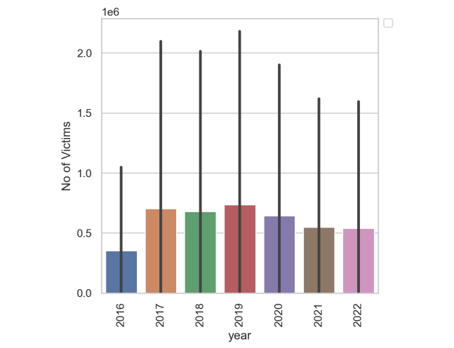
Trends in understanding Number of victims in each year.

Slide 22
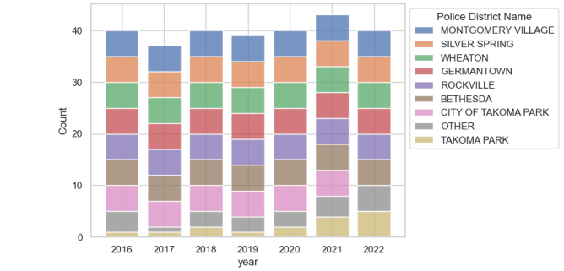
Trends in understanding the number of crimes reported in different police districts throughout the years.

Slide 23
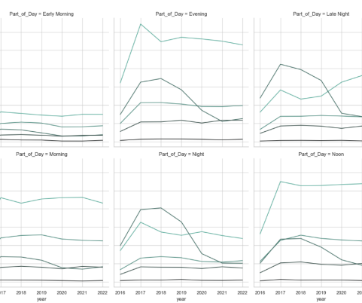
Trends in understanding occurrence of crime name1 in particular part of the day throughout the years.

Slide 24
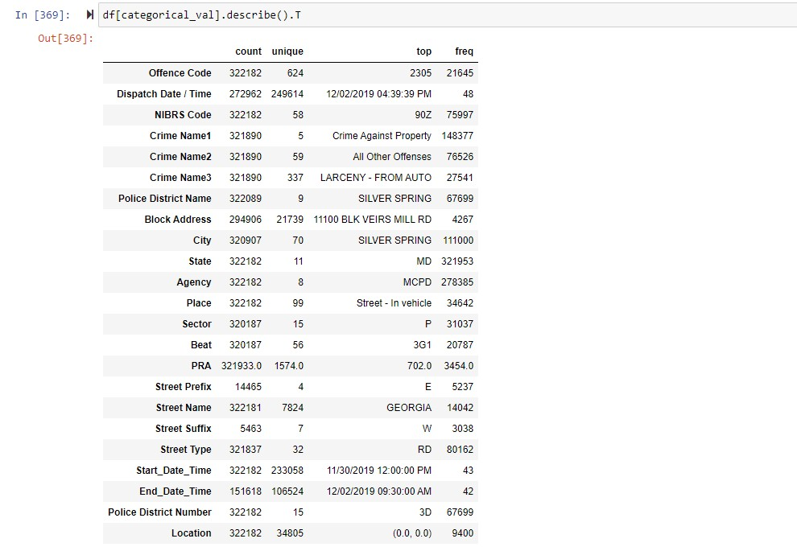
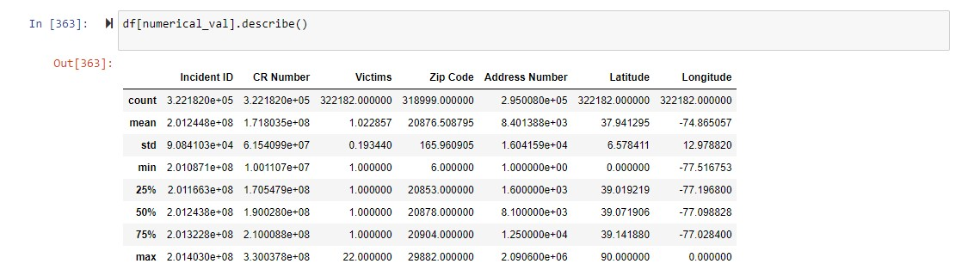
Descriptive statistics
Finding statistical values like mean and median for the supplied dataset is challenging since it comprises so many categorical values. However, for the categorical value statistical measure, only provide information about frequency counts, top, and unique value counts for the specified columns.

Slide 25

Research Questions:
What are the common time frames when these crimes took place?
Based on the descriptive analysis as per Data set, what are the patterns of crimes taking place over the years?
Categorizing the types of crimes that look place, which crime occurs the most in those specified categories?
What is the percentage of crimes happening in a particular street?
Which location has the greatest number of crimes in each county?

Slide 26
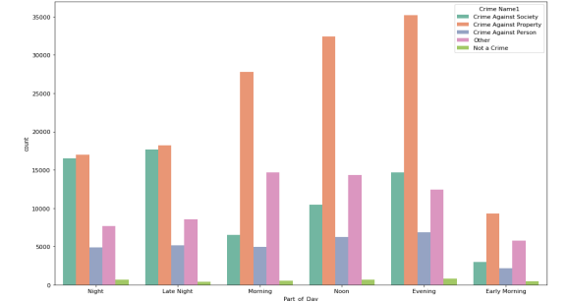
What are the common time frames when these crimes took place?

Slide 27
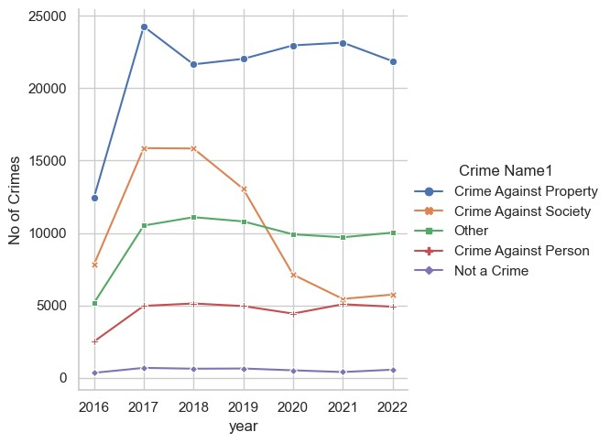
Based on the descriptive analysis as per Data set, what are the patterns of crimes taking place over the years?

Slide 28
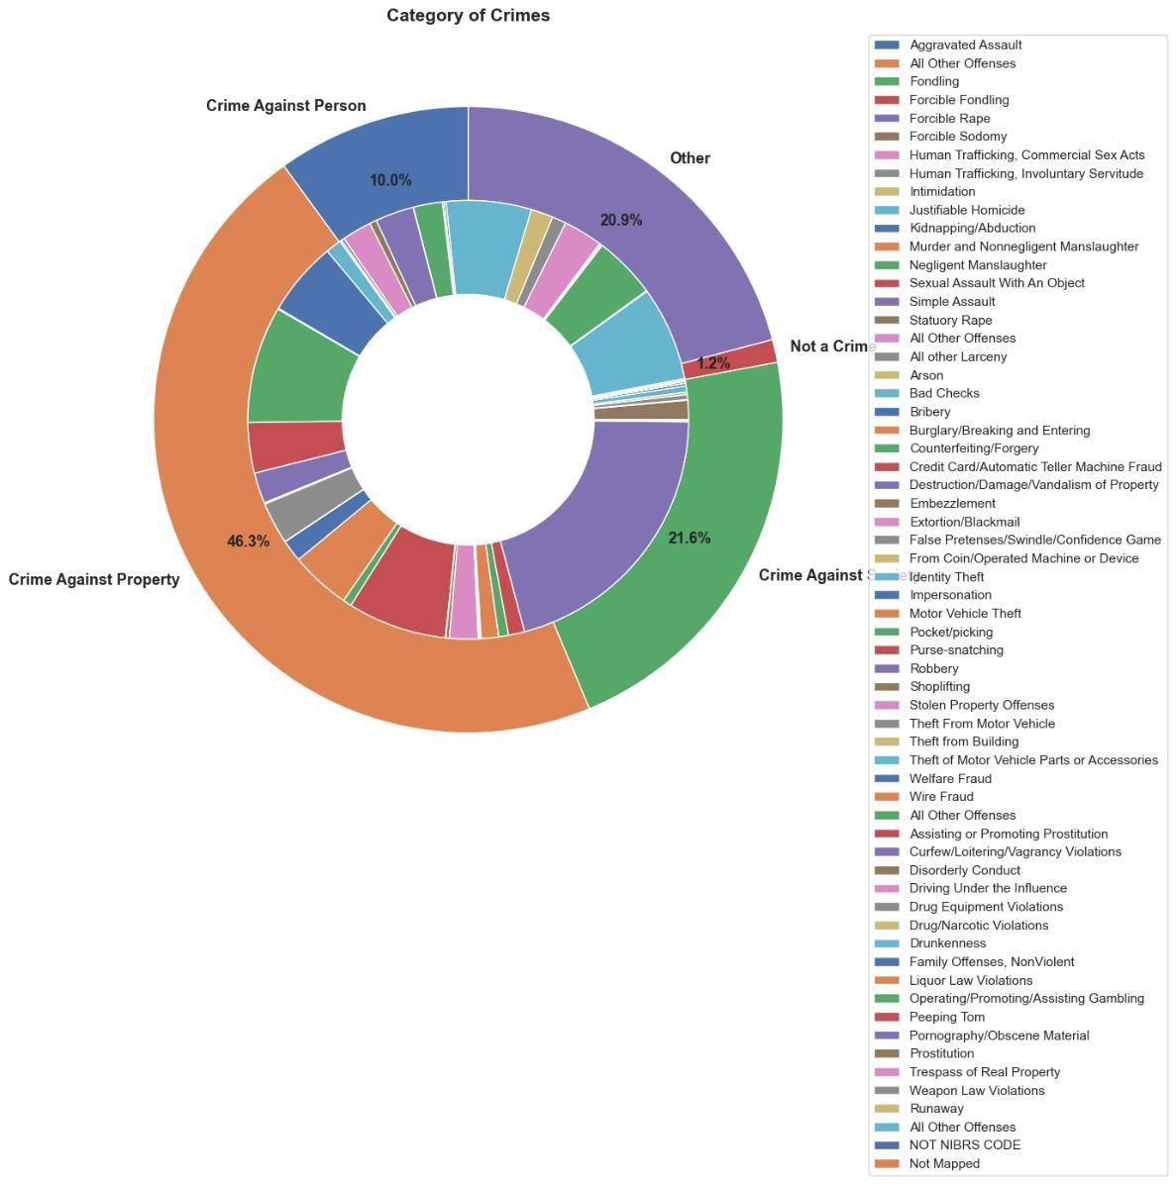
Categorizing the types of crimes that look place, which crime occurs the most in those specified categories?

Slide 29
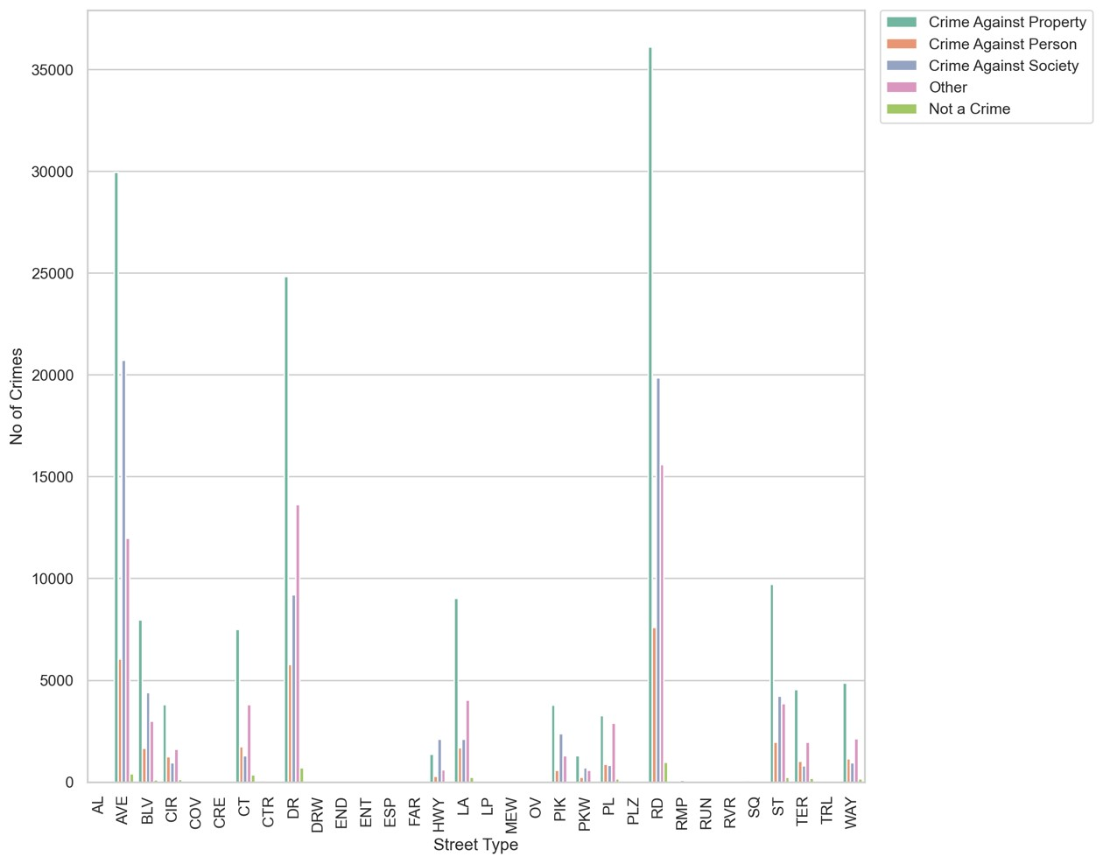
What is the percentage of crimes happening in a particular street?

Slide 30
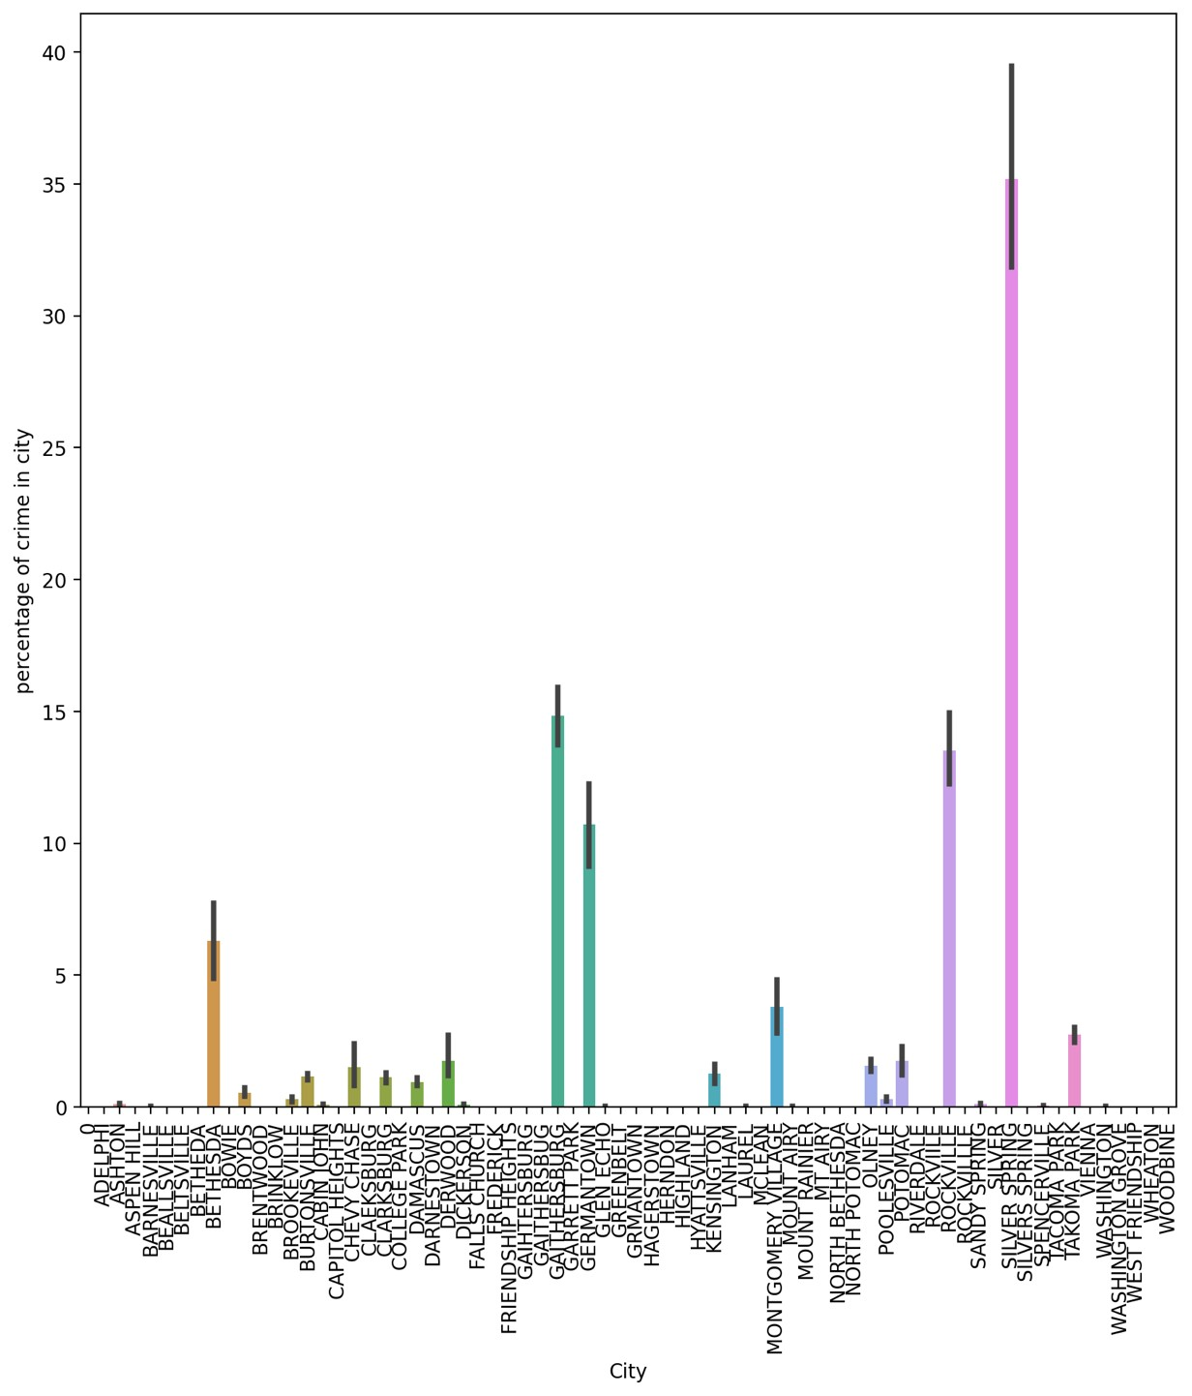
Which location has the greatest number of crimes in each county?

Slide 31
Conclusions and Solutions
Conclusion:
Highest Crime Region : Silver Spring
Duration when crimes are more : Afternoon and Evening
Police District where most number of Crimes recorded : Silver Spring, Wheaton , Bethesda
Highest Categories of Crimes : Crime against property and Crime against person.
Solutions:
Installing Cctv’s for eery lanes with night vision
Making home security solutions more stronger
Increasing police staff for patrolling during night time in High alerted zones.
Licensing all blunt objects like knife, Keychains.
Funds for more staff categorising and focusing each staff for specific set of crimes.

Slide 32
Thank you

